Slide 1
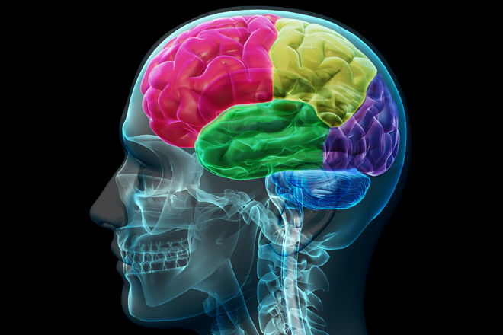
The Behavioural Sequelae of a significant injury to the Brain and the impact for others
Gus A Baker PhD FBPS
EM Professor of Clinical Neuropsychology and
Hon Consultant Clinical Neuropsychologist
Walton Centre for Neurology and Neurosurgery
University of Liverpool
Notes:
Good afternoon. I would like to start my thanking the committee for allowing me to attend your meeting and to share some of our work. I am part of a multidisciplinary group who have undertaken a series of projects investigating neurodevelopmental outcomes following in utero exposure to AEDs. The data here is from a recent collaborative project undertaken with the UK Epilepsy and Pregnancy Register, undertaken with the aim to reduced the latency between onset of newer AED use and knowledge of potential neurodevelopmental risks.

Slide 2
The event
Traumatic Brain Injury - A bolt or jolt to the head or a penetrating head injury that disrupts the function of the brain
Not all blows or jolts to the head result in a TBI. The severity of such an injury may range from “mild” (a brief change in mental status or consciousness) to “severe” (an extended period of unconsciousness or amnesia) after the injury.

Slide 3
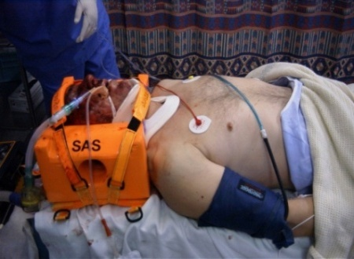
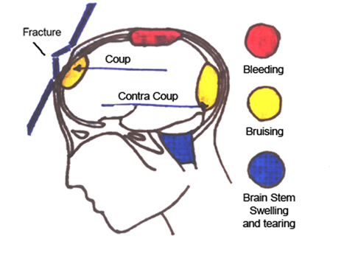
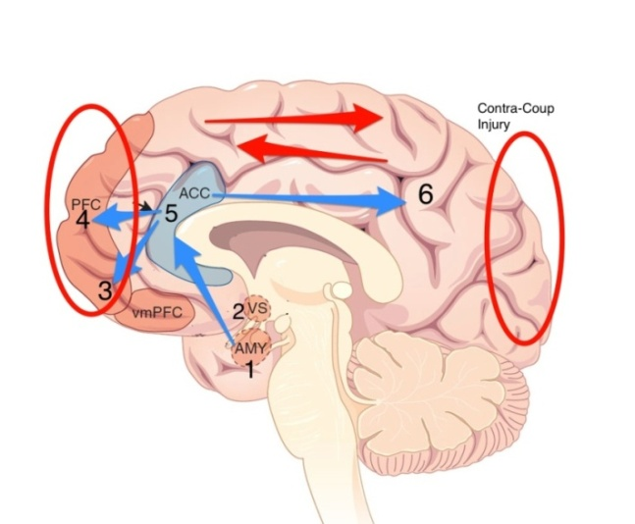
TBI: Mechanism
Moderate-Severe TBI (e.g. 30 mins + LoC)
insult to the brain from an external mechanical force.
E.g. blow to the head - “fast-stop” in a crash, assault, fall.
frontal and temporal most common sites of injury
Contusions, lacerations etc.
diffuse injury (eg diffuse axonal shearing) across the brain
In MILD TBI – same mechanisms - but difference of degree of “dosage” (LOC or repeated injury) (Bigler, 2008)

Slide 4
Brain Behavior Relationships
Frontal Lobe • Initiation • Problem solving • Judgment • Inhibition of behavior • Planning/anticipation • Self-monitoring • Motor planning • Personality/emotions • Awareness of abilities/limitations • Organization • Attention/concentration • Mental flexibility • Speaking (expressive language)
Parietal Lobe • Sense of touch • Differentiation: size, shape, color • Spatial perception • Visual perception
Occipital Lobe • Vision
Cerebellum • Balance • Coordination • Skilled motor activity
Brain Stem • Breathing • Heart rate • Arousal/consciousness • Sleep/wake functions • Attention/concentration
Temporal Lobe • Memory • Hearing • Understanding language (receptive language) • Organization and sequencing

Slide 5
Changes in Personality and Behaviour

Slide 6
Volunteer

Slide 7
Personality characteristics

Slide 8
Neuropsychological Assessment
Background
Clinical markers for brain damage
PTA
GCS
Imaging
Recovery
Neuropsychological Assessment
Interpretation of test results
Formulation

Slide 9
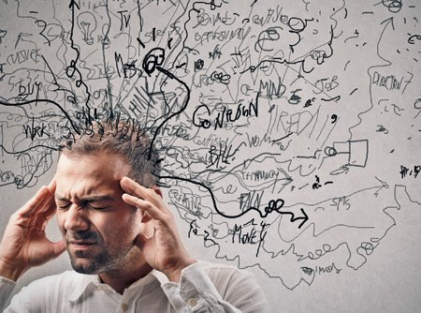
Neuropsychological Assessment
Key areas
Attention and Concentration
Intellect
Memory
Executive Functioning
Personality and Behavioural changes

Slide 10
Common Consequences of a brain injury
Poor memory
Lack of insight
Poor planning and problem solving skills
Inability to understand and communicate
Poor concentration
Poor perception, recognition and judgement
Inappropriate behaviour
Slowed responses
Lack of initiative
Loss of physical sensations
Personality changes
Loss of skills, management and day to day affairs

Slide 11
Common Behavioral Complaints
Provided by family members
Impaired Judgment
Impatience
Depression
Hypersexuality
Hyposexuality
Dependency
Silliness
Aggressiveness
Apathy
Immaturity
Disinhibition
Loss of interest
Anxiety
Inability to recognize social cues

Slide 12
Formulation of Personality and Behavioural changes
Medical History
Premorbid functioning
Family
Individual
Employers
Partner
Friends

Slide 13
Unawareness or lack of insight might look like… (Capuco & Freeman-Woolpert)
Insensitivity, rudeness
Overconfidence
Seems unconcerned about the extent of her/his problems
Doesn’t think he/she needs supports
Covering up problems (“everything’s fine…”)
Big difference in what he/she thinks and what everyone else thinks about his/her behavior
Blaming others for problems, making excuses

Slide 14
Personality and behavioral changes
Problems with initiation
Reduced self-esteem
Difficulty relating to others
Difficulty maintaining relationships
Difficulty forming new relationships
Stress/anxiety/frustration and reduced frustration tolerance
What might be the cause of these changes?

Slide 15
Frontal Lobes
Very susceptible to damage
Planning
Judgment
Verbal fluency
Time span
Attention
Conceptual shifts
Insight and foresight
Ordering and sequencing
Visual scanning and shifting
Inhibition
Motor regularity control
Emotional regulation

Slide 16
Symptoms of Frontal Lobe lesions
Reduced inhibition and abnormal sexual behaviour
Failure to identify facial expressions
Reduced verbal fluency
Reduced sexual behaviour [dorsolateral region]
Increased perseveration
Inability to form a strategy
Impaired temporal memory
Impaired working memory
Increased risk taking
Impaired self-regulation
Loss of associative learning
Loss of response inhibition
Impaired divergent thinking
Loss of behavioural spontaneity
Reduction in general behaviour

Slide 17
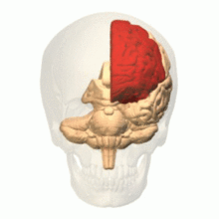
The term executive function describes a set of cognitive abilities that control and regulate other abilities and behavior
They are necessary for goal directed behaviour and include the following:
The ability to initiate and stop actions
The ability to monitor and change behavior as needed, and to plan future behavior when faced with novel tasks and situations.
The ability to anticipate outcomes and adapt to changing situations

Slide 18
Impact of Impaired Executive Functioning
Most people experience impulses to do or say things that could get them in trouble, such as making a sexually explicit comment to a stranger, commenting negatively on someone's appearance, or insulting an authority figure like a boss or police officer; but most people have no trouble suppressing these urges.
When executive functions are impaired, however, these urges may not be suppressed. Executive functions are thus an important component of the ability to fit in socially.

Slide 19
Case of MR C
Pre-accident
Moderately severe head injury
No premorbid psychological and neuropsychological problems
Strong family relationship
Responsible job
Post accident
Mild to moderate Neuropsychological problems
Loss of employment
Significant changes in Personality and Behaviour
No longer expresses any concern or affection
Emotional [anger and frustration, odd behaviour]
Cognitive [memory, attention and concentration, motivation, organisational skills, ability to manage finances speech and word finding]
Social skills [misinterpretation],
Physical difficulties [fatigue, bladder problems, balance, headaches, sense of smell and taste, weight gain]
Psychological problems
Mrs C has reported that she no longer feels a wife to her husband but more like a carer. Children are confused and concerned

Slide 20
Ameliorating the personality and behavioural changes following TBI [Care givers website]
Personality Changes
It may be, for example, that the head injury survivor used to be easygoing, energetic, and thoughtful and now seems easily angered, self-absorbed, and unable to show enthusiasm for anything. Nonetheless, try not to criticize or make fun of the impaired person’s deficits. This is sure to make the person feel frustrated, angry, or embarrassed.
Lack of Emotion
After a head injury, a person may lack emotional responses such as smiling, laughing, crying, anger, or enthusiasm, or their responses may be inappropriate. This may be especially present during the earlier stages of recovery.Recognize that this is part of the injury. Try not to take it personally if the person does not show an appropriate response.
Emotional Lability
Overreactions could be sudden tears, angry outbursts, or laughter. It is important to understand that the person has lost some degree of control over emotional responses. The key to handling lability is recognizing that the behavior is unintentional. Caregivers should model calm behavior and try not to provoke further stress by being overly critical. Help the person recognize when his/her emotional responses are under control, and support/reinforce techniques that work.

Slide 21
Treatment of the Silent epidemic
Neuropsychologists, Occupational Therapists, Support workers, Sppech and Language Therapists
In addition to assessment of cognitive and behavioral functioning, these providers offer therapy services to persons with TBI and other affected individuals (e.g., family members).
Goals of therapy can include:
Identification of specific strategies to manage behavioral changes from TBI.
Anger management, impulse control strategies
Emotional lability
Reduced motivation/apathy
Help with psychological adjustment to changes in functioning caused by the TBI.
Address lowered self-esteem secondary to TBI-related difficulties.
Provide specific strategies for managing depressed mood, anxiety.
Assist with adjustment to changes in family roles that can occur after a TBI (e.g., if parent with TBI now requires help from the child in doing daily activities).
Management Strategies for Behavioral/Emotional Issues
Treatment from healthcare professionals plays an important role in helping address behavioral/emotional issues in persons with TBI, whether they are having a modest or significant impact on the person's functioning.

Slide 22
The role of others in the Rehabilitation Process
Strategies for Others
Work with the person with TBI to identify situations that are associated with emotional lability (e.g., frustration, fatigue).
Use some basic strategies to de-escalate potentially problematic situations:
Recognize early signs of increased emotionality.
Use distraction to decrease focus on cause of emotional reaction.
Encourage/help the person take a break from the situation associated with the emotional reaction (e.g., leaving the room and going to a safe, quiet place).
When the person is emotionally labile, maintain an interactional style that is non-confrontational and soothing (e.g., speaking in a calm voice, with non-threatening body language).
Acknowledge the person's distress and help with problem-solving if possible.
During non-emotional times, help the person identify words that can be used to communicate with others about his/her emotions.
DON'T engage in discussions/arguments with the person when he/she is experiencing high levels of emotionality.
DON'T further escalate the person's emotions by responding with intense emotions.
DON'T try to reason with the individual during periods of high emotionality

Slide 23
Reflections on clinical experience to date
Always educate the family about the basics of TBI
Involve the family in the rehabilitation process from day one.
Recognise that when all the professions have left, it is usually left to the family to cope
Make families aware of support organisations such as Headway.
Campaign for more support for family members

Slide 24
Thank you for your time and attention
The Walton Centre
For Neurology and Neurosurgery
Gus A Baker
5/17/2018
24
Notes:
Good afternoon
I would firstly like to thank the association for allowing me this opportunity to present to you our data on developemental outcomes in children after in utero exposure to and antiepileptic drug Levetiracetam.
24

