Slide 1
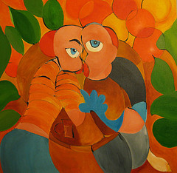
Sexuality after Brain Injury
Dr Giles Yeates
Principal Clinical Neuropsychologist & Couples Therapist
Charlie Wilson
Trainee Clinical Psychologist
Community Head Injury Service, Buckinghamshire Healthcare NHS Trust, Aylesbury, UK & University of Oxford.

Slide 2
1st Step to being supported…
Being asked!
How have things changed?
What is the impact of these changes on your life, your identity, people close to you?
Many services neglect these questions
Fewer still offer support to manage these issues

Slide 3
“Professionals frequently ignore, avoid or quite innocently overlook the sexual needs of their patients until they begin to exhibit sexually inappropriate behaviour”.
Miller (1994, p.19)

Slide 4
Common reasons for Decrease in Sexual Drive, Arousal, Ability
Direct Effects of Injury
Mood & Confidence
Side-Effects of Medication
?

Slide 5
Specific cognitive difficulties & sex (1): Tuning into bodily sensations (Yeates et al, in press)
D: it’s weird to say this but when we’re kissing and cuddling I feel quite strange /// I guess I feel that way when..I get lost…in umm.. the development… of.. Our arousal.. umm… it’s a case of .. not being mentally aware, I suppose …that’s my feelings, I know how I’m feeling.. but it’s a case of how Monica is feelings, but again, it’s signs again….///recognising it, that’s different
G: and you’re feeling a bit adrift from it
D: very much so
G: and that feels strange
D: very-… I’ve never been that way with Monica ///… ummm.. it’s a weird sensation, I suppose…ummm, my stomach as well as anything else …..around my stomach, and around my heart areas… it doesn’t feel right. Where before.. it flowed, it went and in every aspect of the admiration, the kiss, the cuddling to intercourse it flowed from year dot to the end

Slide 6
Specific cognitive difficulties & sex (2): switching attention
“There can’t be any unplanned time sharing with each other. I have to mentally know when it’s going to happen so I can prepare because I can’t switch gears anymore”. Gill et al., 2011

Slide 7
Powerful Cultural Messages about Sex
men must instigate sex
men should not express their feelings
there are certain absolute, universal rules about what is normal in sex
if a man loses/is unable to get an erection, he is:
not attracted to his partner
not aroused
not able to have sex
Sex should always be natural and spontaneous

Slide 8
1 2 3 4 5 6 7 8
Less diversity
Greater Diversity
1. Intercourse
2. Genital Stimulation
3. Direct Physical Contact
4. Indirect Physical Contact (Implied or desired)
5. Nonphysical Contact (effects of words, gestures, mind)
6. Intimacy (moments of care, affection, attention)
7. Language of sex, desire, sexual normality
8. Internal thoughts, fantasies, feelings

Slide 9
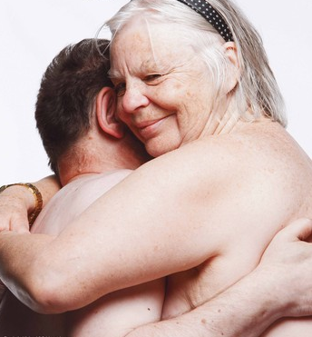
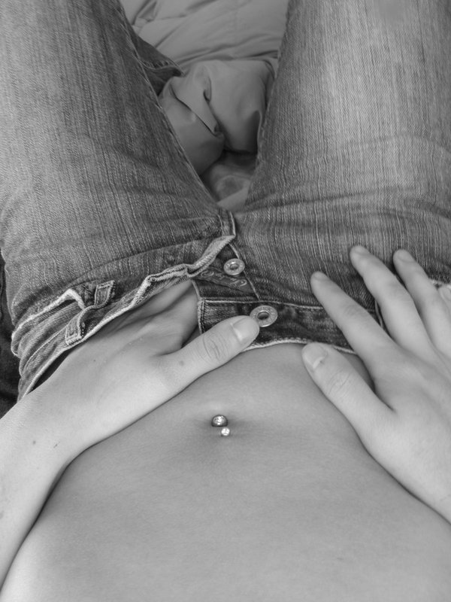
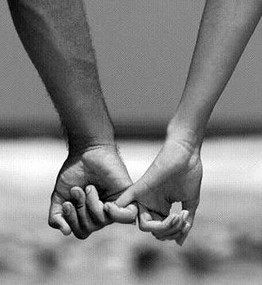
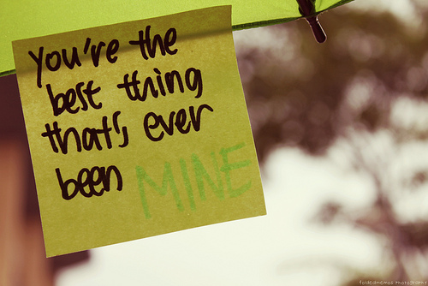
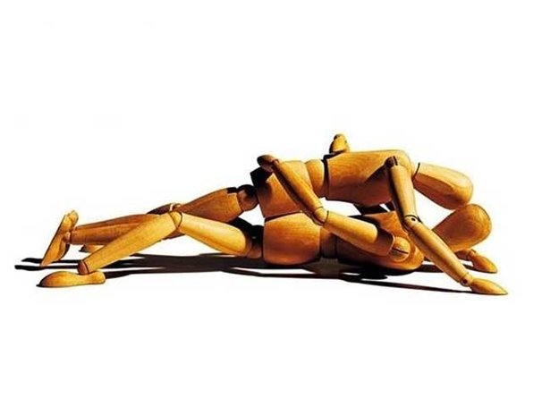
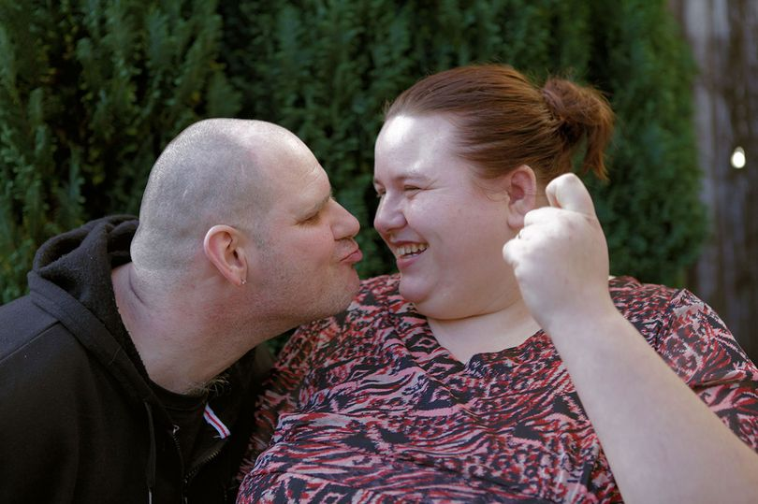
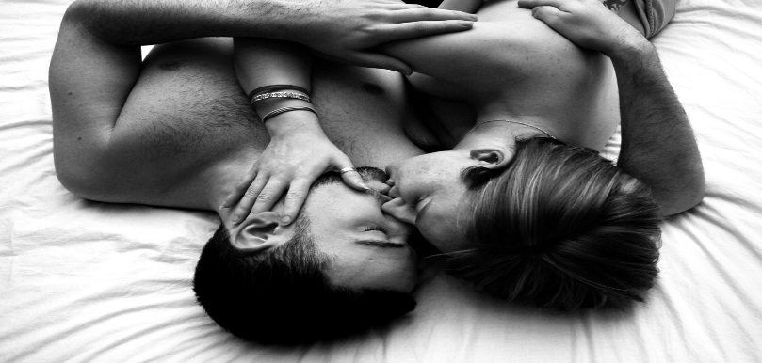
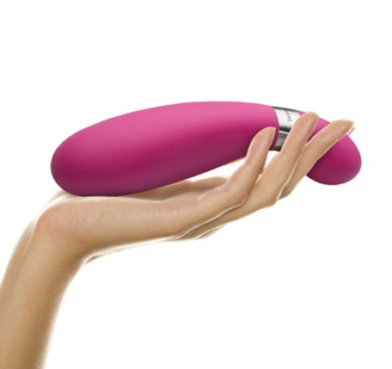

Slide 10
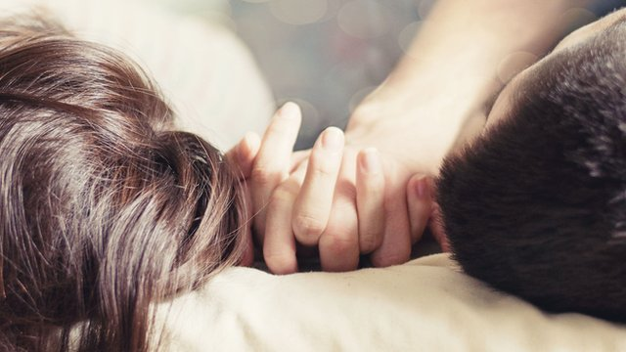
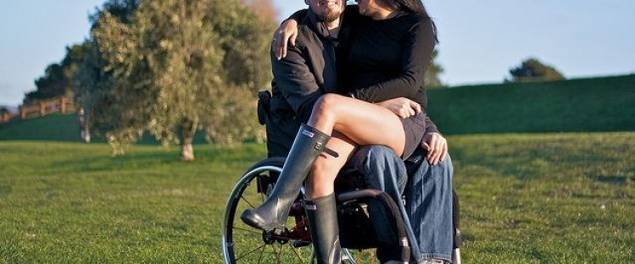
Care giving and sexual intimacy
“It’s the lingering and holding. We don’t have that anymore. That’s what I miss the most”
“I feel kind of awkward about things. What can we do now”
“I would like more hugging and kissing, the nurturing that kind of loving feeling”
“We cant have real sex anymore”

Slide 11
“dilemma of caregiving”
Chronic illness and disability, such as living with a brain injury can challenge the physical and emotional boundaries of our relationships.
The dynamics of care can interfere with sex, intimacy, and physical contact– for both partners
Reduce sexual intimacy
Changes roles and status in relationship
Lovers and sexual partners
Nurse/carer and patient
Parent and child

Slide 14
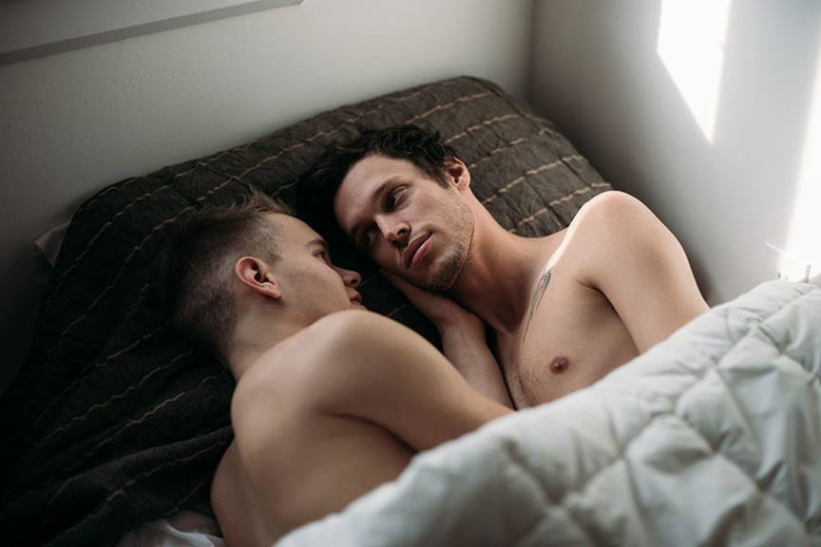

Slide 16
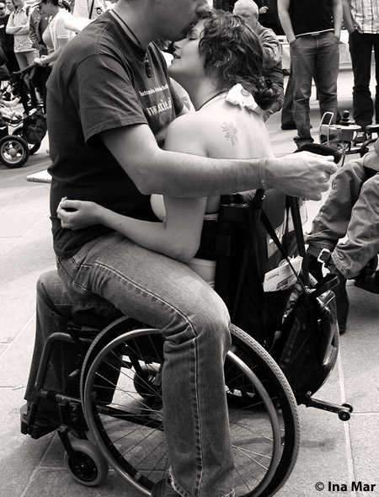

Slide 20
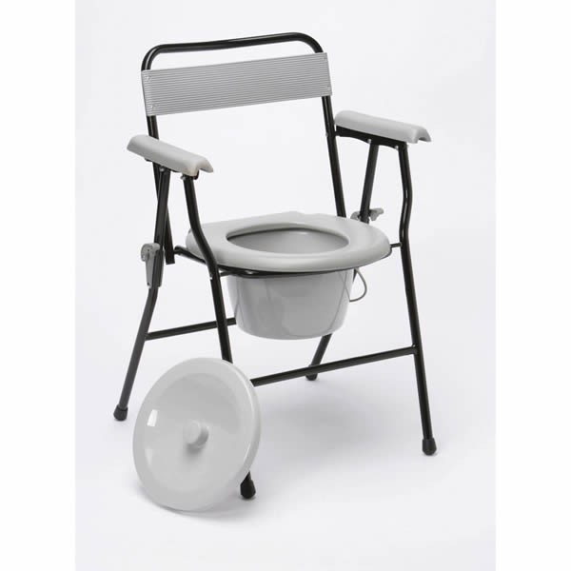

Slide 22
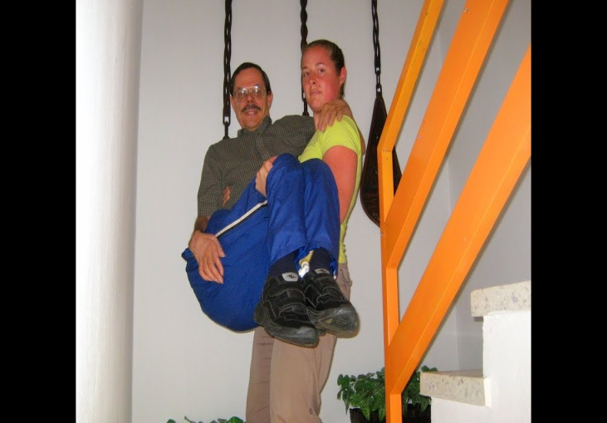

Slide 23
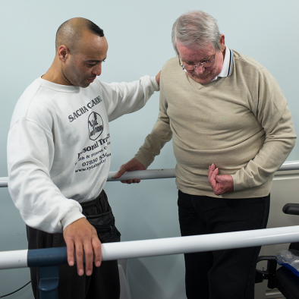

Slide 24
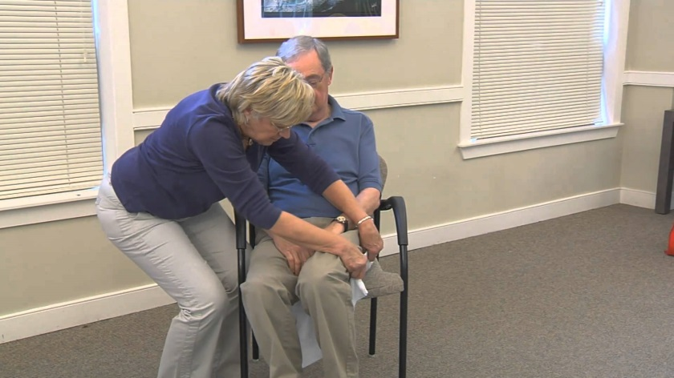

Slide 25
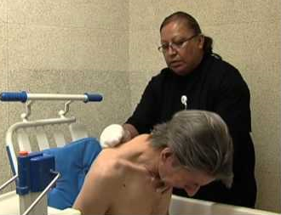

Slide 26
“dilemma of caregiving”
Harder to see partner sexually when doing personal care tasks
Role can seem incompatible with a sexual relationship
Unsure where to set boundaries
Unsure whether its “morally” right now - guilt
Sex can feel inappropriate or frivolous
If sexual intercourse reduces other forms of physical touch and intimacy can also reduce
Notes:
Hard to get moments of intimacy
Fear around discussing alternatives
Needs of carer repressed
Personality changes

Slide 27
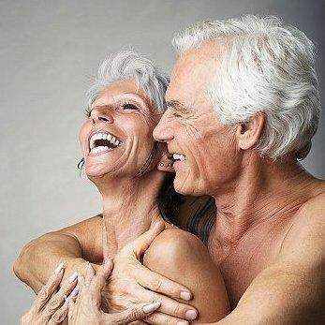
When you’re a carer its hard to be a lover, for either party. Dealing with incontinence, and the daily grind of washing, dressing, shaving…”
“Its deteriorated into a parent-child relationship which neither of us want it to be”
“Its like looking after one of your children now.”

Slide 28
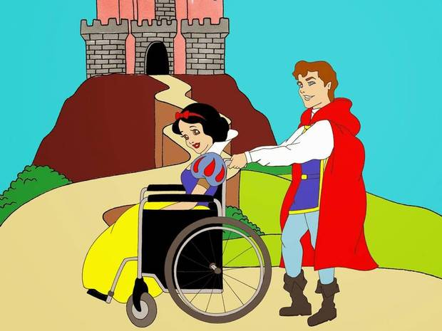
“You feel more like a father than a lover, someone has to be there to give her tablets, make sure she’s allright”
My role of carer has overridden my role as wife”
“I feel more like a caretaker than a spouse. I’ve lost that wife position”

Slide 29
Being cared for
Can feel a reduced sense of own sexuality
Feeling unwanted or unattractive
Dependency
Feeling infantilised – or childlike
Perceived obligation of partner
Physical and cognitive changes – not able to be passionate or engage in sex as you did before
Am I a real ‘man’ now if can’t have full sexual intercourse?
Notes:
Care and overprotection emphasises loss of status in relationship and dependency
Changes in expression or style of sexual intimacy
Uncertainty around how to re-establish intimacy

Slide 30
“Your limbs don’t move the way you want them to. You cant get the words out the way you want them to. Your brain is saying do this, but its not happening. You feel like you’re letting them down”
“You’re supposed to be carrying your wife upstairs in your arms, all these macho things”
“I am dealing with insecurities about myself since the accident, prevents me from being in the mood”

Slide 31
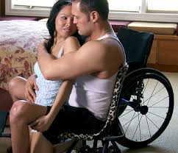
“Not being able to give him a real hug…even just like kisses because my right side is affected. The passion goes out of it”
“She wants it over and done with as quickly as possible”
“When we did have sex, she would accuse me of not treating her the same as I did in the past”

Slide 32
Sexuality after Brain Injury
Many people report difficulties with sex and relationships following brain injury
These can occur for a range of reasons
Sex can be broadened out widely to include far greater diversity of experience
Support is available to help couples and individuals with their sexuality and intimate relationships after brain injury

Slide 33
Help & Resources (1)
Information
South Cumbria Community ABI Team Sexuality Leaflet
Relationship Support
Couples therapy, RELATE
“Hold Me Tight” book by Sue Johnson
Disability Dating Websites:
Accessibility? Completing profiles yourself versus a company doing this with you?
www.outsiders.org.uk ? Receptive to survivors of brain injury?
www.freemyability.com
www.flameintroductions.co.uk (contact Christine Trigg. One-off fee of £695, not payable until 1st introduction. Aim of 4-5 introductions per year)
Summary of all agencies featured in channel 4’s “Undateables”:
www.able2uk.com/news/tv-film/dating-sites-covered-in-the-undateables.html

Slide 34
Help& Resources (2)
Disability & Sexuality:
Psychosexual therapists
Sexual Health Clinics,
Escorts specialising in clients with disabilities
Grahaeme Simpson’s “You and Me” Brain Injury Sexuality Programme in Australia
General Disability & Sexuality Websites:
www.beecourse.com
http://disabilityhorizons.com/category/relationships
www.maryclegg.com

